Slide 1

Churn Analysis in Subscription-Based Businesses from Prediction to Inference
Final project and presentation
Reported by Group 18
Supervisor: David HASON RUDD
Speakers: Yangyang, Weilin, Jim, Sammi
The report date: 05/18/2022

Slide 2
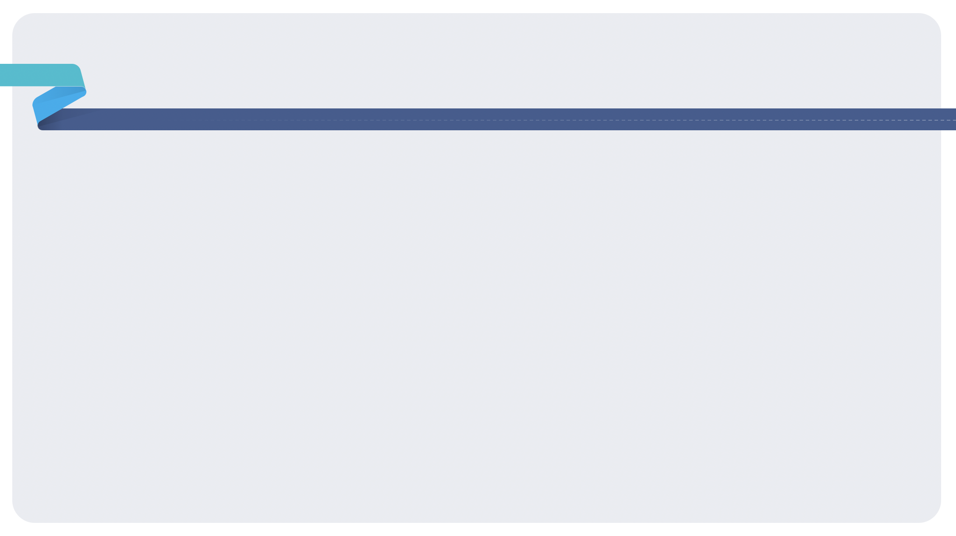
Contents
1
Project Description
2
Modelling
3
Experiment Analysis & Finding
4
Recommendation
5
Challenges Encountered
6
Deployment

Slide 3

1.0 Project Description
Project Background
Business Problem
Available Solution

Slide 4

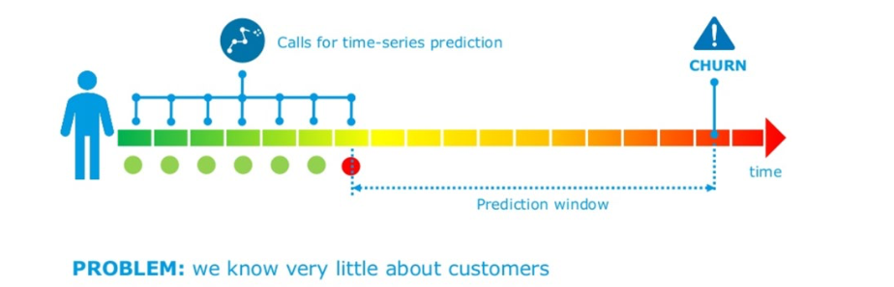
Project Description
Churn Analysis
Business Problem:
The cost of acquiring new customers and rate of customer churn, both are increasing at a rapid pace
The average churn rate is high
The high rate of customer churn leads to a decline in the company’s profitability
We know very little about members data

Slide 5
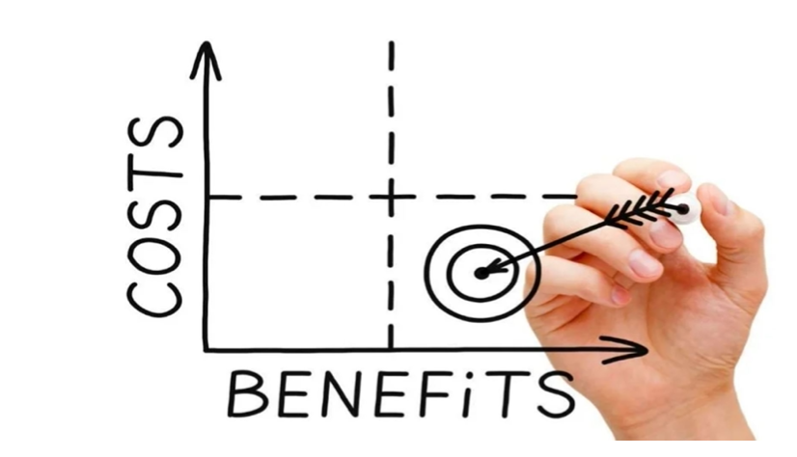
Project Description
Churn Analysis
Data description:
The data set was collected from CFS customers' membership records for June and December 2015, including age, account tenure, savings plans, billing information, service records. etc.
The volume of this dataset is relatively large, a single dataset contains nearly 270,000 member records and 88 behavioural attributes

Slide 6
Project Description
Churn Analysis
How do we preprocess or clean the data?
Data integration:
To save data storage space and improve write performance, thereby improving the model accuracy
One-Hot Encoding:
Make our training data easier to use and more expressive
Data normalization
Eliminate the dimension and simplify the model, thus speeding up the calculation.

Slide 7
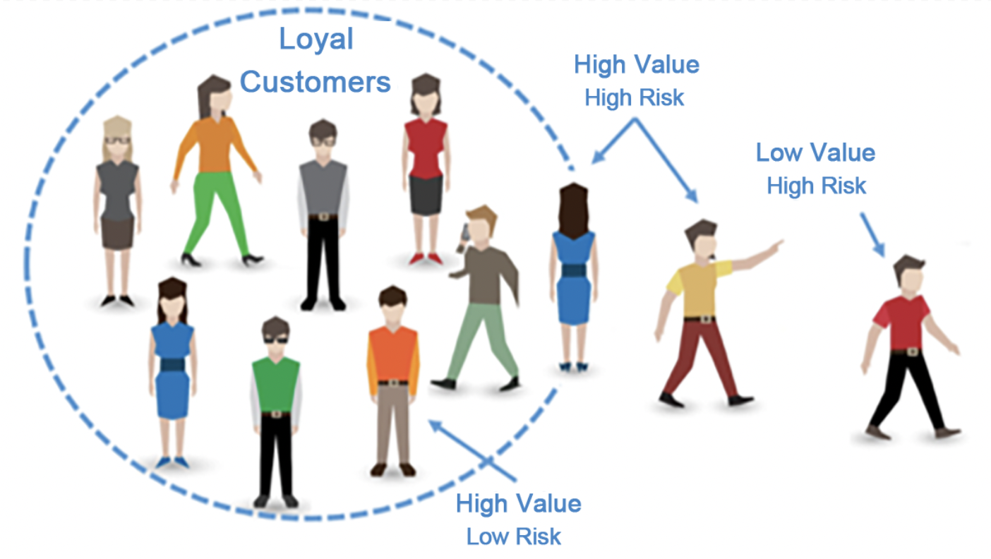
Project Description
Churn Analysis
Available Solution:
Need to build a robust churn propensity model that can classify and score each customer's churn over the next six months.
Employed causal Bayesian networks to predict cause probabilities that lead to customer churn and determine dependency levels between features

Slide 8
2.0 Modelling
What have we found on Modelling?
What methods were used to improve the performance of our model

Slide 9
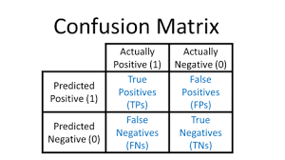


Modelling
Churn Analysis
Precision (Confusion Matrix)
Class agreement of the data labels with the positive labels given by the classifier.
F1 Score
Combination of precision (PRC) and sensitivity (SNS) in a single metric.
AUC Score
AUC score measures the total area underneath the ROC curve.

Slide 10
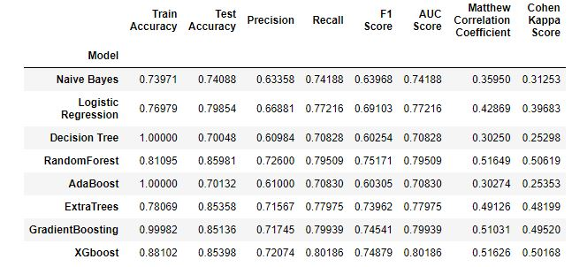
Modelling
Churn Analysis
Baseline Model

Slide 11
Modelling
Churn Analysis
Voting Ensemble
an ensemble machine learning model that combines predictions from multiple other models.
a technique that can be used to improve the performance of a model, ideally achieving better performance than any individual model used in an integration.

Slide 12
Modelling
Churn Analysis
RFE
Recursive feature elimination (RFE) is a feature selection algorithm with a wrapper that minimizes model complexity by selecting salient features and discarding weak features.

Slide 13
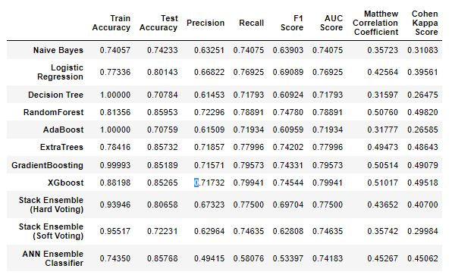
Modelling
Churn Analysis
Final result of Modelling

Slide 14
3.0 Experiment Analysis & Finding
What have we found based on experiments?

Slide 15
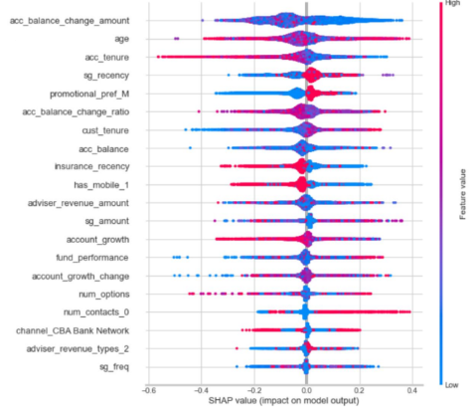
Experiment Analysis & Finding
Churn Analysis
Prediction Result
The most influential features pushing the prediction higher
age
acc_tenure
sg_recency
Features are pulling the model’s prediction lower:
acc_balance_change_amount
acc_balance

Slide 16

Experiment Analysis & Finding
Churn Analysis
Profitability Churner
High Profitability churner
Contribution_frequency” > 6
Confidence (churned)” >= 0.8
Prediction(churn)” = churned
Low Profitability churner
Contribution_frequency” <= 6
Confidence (churned)” < 0.8
Prediction(churn)” = churned

Slide 17
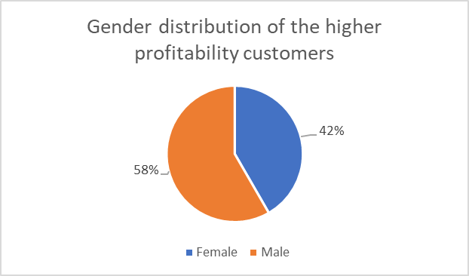
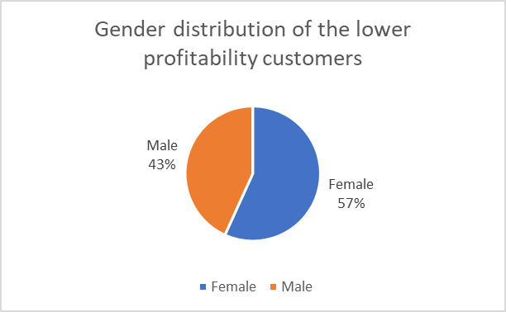
Experiment Analysis & Finding
Churn Analysis
Gender Distribution
Higher Profitability churner
Lower Profitability churner

Slide 18
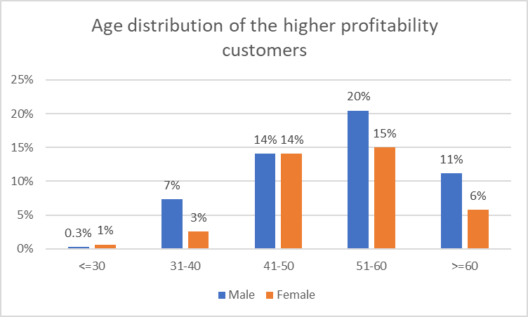
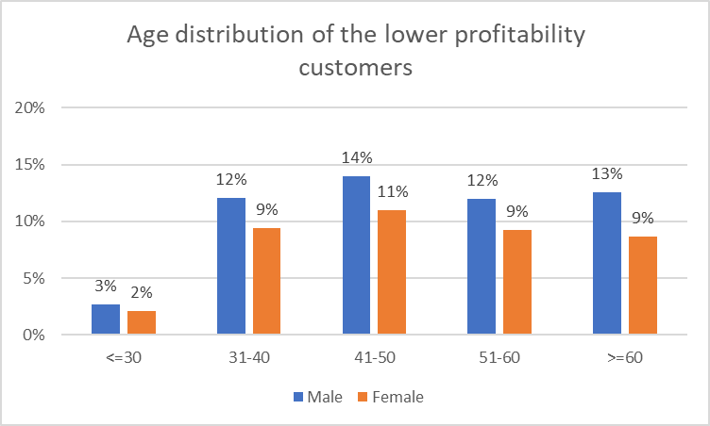
Experiment Analysis & Finding
Churn Analysis
Age Distribution
Higher Profitability churner
Lower Profitability churner

Slide 19
Experiment Analysis & Finding
Churn Analysis
Causal Analysis
Identify the causal effect
Assess the estimated effect on the outcome
Measure causal effect estimation
Refute the obtained estimate
Our assumption is correct if the new estimate effect value is NOT changed

Slide 20
Experiment Analysis & Finding
Churn Analysis
‘Dowhy’ Python Library
Model a causal inference problem using assumptions that we create.
Identify an expression for the causal effect under these assumptions (“causal estimand”).
Estimate uses statistical methods such as matching or instrumental variables for estimating the identified estimand.
Verify the validity of the estimate using a variety of robustness checks.

Slide 21
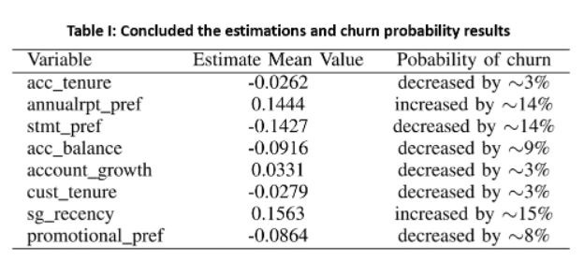
Experiment Analysis & Finding
Churn Analysis
Causal Analysis Result

Slide 22
4.0 Recommendations
What can our client do to solve the business problem?

Slide 23

Recommendations
Churn Analysis
Proactively Communicate with Customers
Maintaining effective communication with customer could prevent customer lost sight of the value of a product as the initial novelty wears off
Define the Most Valuable Customers to the Company
Each churned customer is divided into high-profit members and low-profit members. Our client can offer reward program for high-profit members and encourage the low-profit member
Increase Customer Engagement
Focusing on customers satisfaction can build long-term relationship and increase customer engagement and retention rate
Define a Roadmap for New Customers
A roadmap to guide new customer through the features of the product or services could reduce the possibilities customer loss of interest due to not understanding the product
Collect Customer Feedback
Feedback from customer can help pour client to made immediate changes to increase customer satisfaction

Slide 24
5.0 Challenges Encountered
What challenges have we encountered so far?
How did we overcome them?

Slide 25
Challenges Encountered
Churn Analysis
Challenges:
Time-consuming feature engineering in a massive financial dataset with High-Dimensional Sparse Data.
How to improve prediction confidence in deep learning classification? What is the probability that a customer predicted as a churner is indeed churned?
How to provide a measure of uncertainty in the prediction of customer churn rate?
Solutions:
Using the intrinsic property of Artificial Neural Network (ANN) based on different weights of given historical data.
Propose a casualty analysis method (DoWhy )to predict the set of cause that lead to deliberate churn.
Calculating magnitude of causes by exploiting counterfactual conditions prediction method.
Magnitude of cause = Actual Probability - Counterfactual Probability
Real-World Application: Value-adding strategies for reducing customer churn rate. Marketing team can have better understanding on underlying factors and design better campaigns.

Slide 26
6.0 Deployment
How can the model be integrated into the business information system?

Slide 27

Deployment
Churn Analysis

Slide 28

Thanks for your listening
Reported by Group 18
Supervisor: David Hason
Speakers: Yangyang, Weilin, Jim, Sammi
The report date: 05/18/2022

